Slide 1
Unsupervised Learning
© 2025 Virginia Polytechnic Institute and State University. All rights reserved.
Notes:
Welcome to the module on Unsupervised learning using principal components analysis and clustering. Principal components analysis (PCA for short) and clustering are unsupervised learning techniques, often used together with data visualization to find patterns in your data. As a decision maker, you may use these techniques when you want to summarize data that have a large number of variables. PCA reduces the dimensions of your data through defining new variables that summarize groups of your original variables to explain variability. Clustering identifies patterns in data by grouping common observations. In this module, we will discuss k-means clustering and hierarchical clustering.

Slide 2
At the end of this module, you should be able to:
Identify when unsupervised learning methods might be used
Describe the basic idea behind principal components analysis
Describe the general procedure for k-means clustering
Describe hierarchical clustering and how it differs from k-means clustering
Implement PCA and Clustering methods in Python

Slide 3
Unsupervised Learning

Slide 4
Introduction to Machine Learning Course Roadmap
What is the goal of the data analysis?
Predict an output |  |  |  |  |  | Reveal patterns or relationships |  | Make decisions using an autonomous agent
Supervised Learning (Output in the data set) |  |  |  |  |  | Unsupervised Learning (No output in the data set) |  | Reinforcement Learning* (Supervised & unsupervised)
Continuous or discrete output? |  |  |  |  |  | What is the subgoal? |  | Does a model exist?
Continuous |  |  | Discrete |  |  | Identify groups | Reduce dimensions | Model Based | Model Free
Simple linear regression Multiple linear regression Subset selection Ridge regression & LASSO PCR & PLS | Polynomial regression Step functions Splines Local regression General additive models | Decision tree Random forest Neural network Gradient boosting tree | Logistic regression Linear discriminant analysis Quadratic discriminant analysis | Decision tree Random forest Neural network Gradient boosting tree | Support vector machines | Hierarchical clustering K-means clustering | Principal components analysis | Given the model Learn the model | Policy Optimization Q-Learning
Hierarchical clustering
K-means clustering
Principal components analysis
*Advanced Topic: Bonus module if time
Notes:
In the previous modules, we discussed supervised learning methods for situations where we have a response of interest that we would like to predict. Now we are going to move to the area of unsupervised learning where we no longer have a response. Our goal now shifts to either identifying groups or reducing dimensions

Slide 5
Supervised versus unsupervised again
Some tangible measurement(s)
“The Black Box”
INPUTS
MACHINE LEARNING MODEL
OUTPUT(S)
Supervised Learning
In the context of domain knowledge
“The Black Box”
INPUTS
MACHINE LEARNING MODEL
PATTERNS,
RELATIONSHIPS, STRUCTURE
Unsupervised Learning
does it make sense?
Notes:
Both PCA and clustering fall into the unsupervised learning category. Recall that the key feature of unsupervised learning is that we do not have an output to predict. Instead we are exploring our data for patterns and relationships.

Slide 6
Unsupervised Learning

Slide 7
Unsupervised learning methods are used when there is not an output to predict
Unlike previous methods explored in this course, unsupervised learning is not typically used for prediction
Unsupervised learning methods are instead used to:
Uncover relationships between the features themselves
Produce informative visualizations
We will examine two unsupervised learning methods:
Principal Component Analysis
Clustering
Notes:
Unsupervised methods are often used when we do not have any labels (we don’t know what category an observation is in) and in the context of exploratory data analysis.
We will focus on two particular types of unsupervised learning: principal components analysis, a tool
used for data visualization or data pre-processing before supervised techniques are applied, and clustering, a broad class of methods for discovering
unknown subgroups in data.

Slide 8
Unsupervised learning examples to discover subgroups among variables or observations
Gene expression levels in 100 patients with breast cancer.
Look for subgroups among the breast cancer samples, or among the genes, in order to obtain a better understanding of the disease
Identify groups of shoppers with similar browsing and purchase histories, as well as items that are of particular interest to the shoppers within each group.
An individual shopper can be preferentially shown the items in which he or she is particularly likely to be interested, based on the purchase histories of similar shoppers

Slide 9
Unsupervised Learning

Slide 10
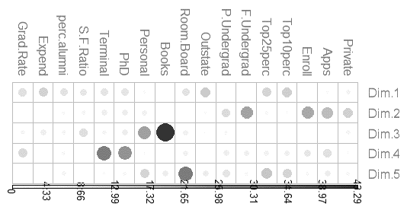
Start with larger set Reduce to smaller set
PrincipalComponent1
PrincipalComponent2
PrincipalComponent3
PrincipalComponent4
PrincipalComponent5
Private
Top25perc
Books
perc.alumni
Apps
F.Undergrad
Personal
Expend
P.Undergrad
PhD
Grad.Rate
Enroll
Outstate
Terminal
Top10perc
Room.Board
S.F.Ratio
Dimension Reduction
PCA reduces the dimensionality of the data set, allowing most of the variability to be explained using fewer variables.
Notes:
We talked about Dimension reduction in Chapter 6 when we talked about Principal Components Regression.
Recall, we used PCA to reduce the number of variables that would then be used as predictors for regression. Here we will talk about using PCA as an unsupervised method that can help us understand data when we do not have data with labels. In this context, PCA can help us identify groups or clusters.
Dimensions that make sense which brings in subject matter knowledge
Recall the college application example
We are interested in predicting the number of accepted college applications
Our dataset contains 17 possible predictors (or inputs or Xs)

Slide 11
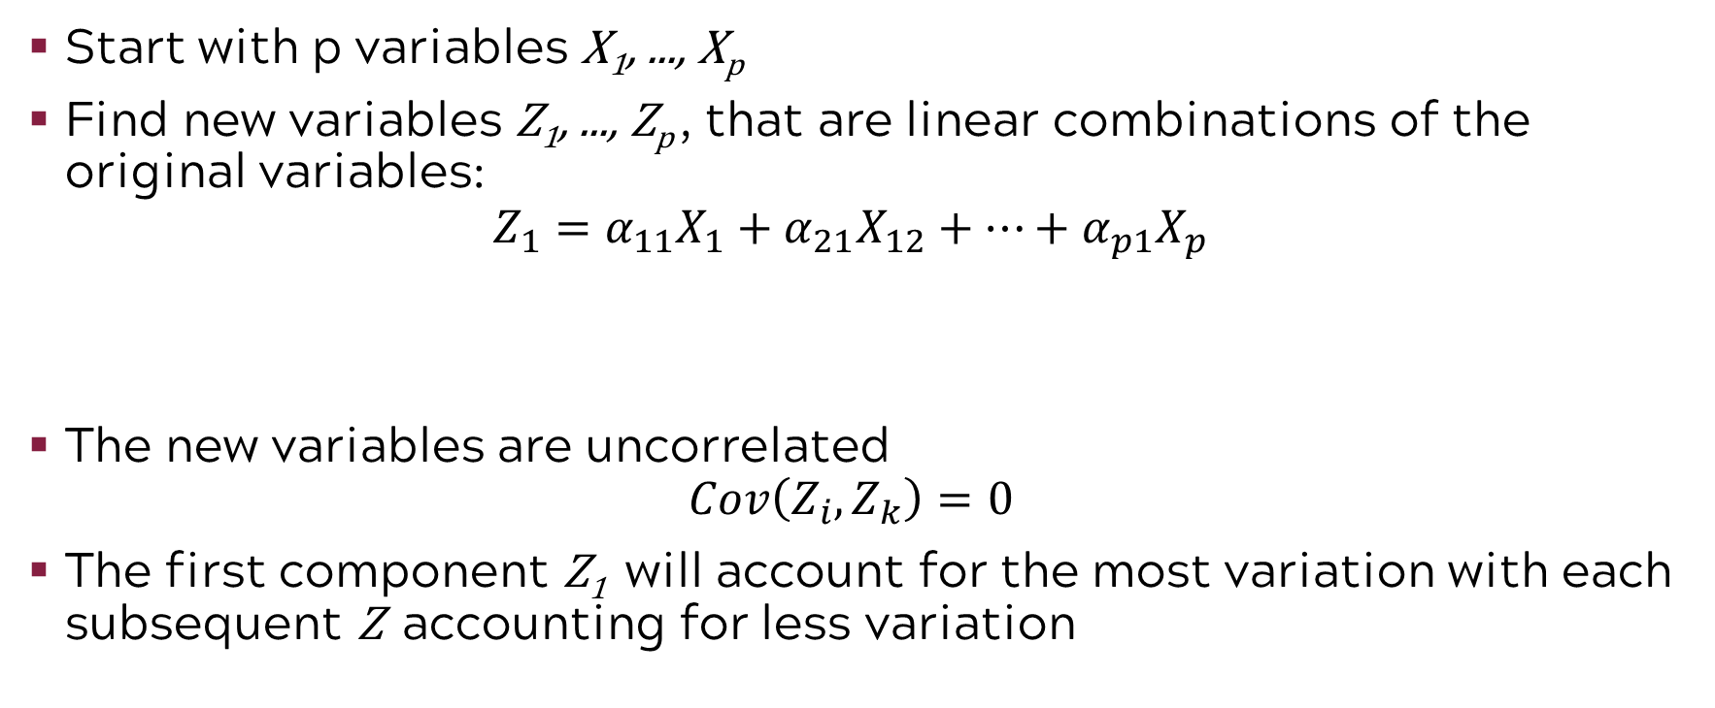
PCA basics
Start with p variables X₁, ..., X_{p}
Find new variables Z₁, ..., Z_{p} , that are linear combinations of the original variables:
$$Z_{1}=α_{11}X_{1}+α_{21}X_{12}+⋯+α_{p1}X_{p}$$
The new variables are uncorrelated
$$Cov\left(Z_{i}, Z_{k}\right)=0$$
The first component Z₁ will account for the most variation with each subsequent Z accounting for less variation
one for each principal component
loadings for the principal component

Slide 12
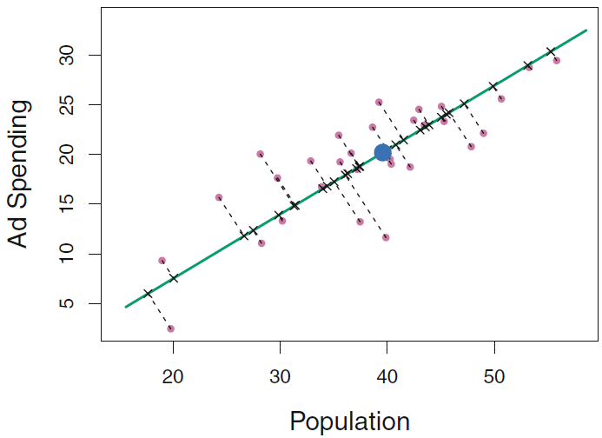
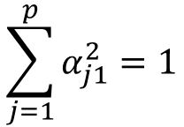
A conceptual introduction to principal components
The green line represents the 1st PC. This is the line (or plane) closest on average to all the data points subject to the constraint:
$$\sum_{j=1}^{p}{α_{j1}^{2}=1}$$
Notes:
Recall the conceptual introduction from our earlier module on linear model improvements with principal components regression.
Principal components works with a large number of X’s but it helps to look at a simple case to understand what is happening in PCA.
Consider two variables population size and ad spending. We will find the alphas by finding the line/plane that is closest on average to all the data points while normalizing the coefficients of the linear form as follows so that the sum of the squared coefficients adds to 1.
PCA finds the line/plane that is closest on average to all the data points while normalizing the coefficients of the linear form as follows:
This figure may help clarify what we mean by the variable Z being a linear combination of existing variables. In the figure, we observe that, for example, spending on advertising has an almost perfectly linear relationship with the population in the target area. Therefore, we can create a new variable that essentially captures where we are on the line between them

Slide 13
PCA can be used for dimension reduction as well as visualization
We discussed PCA as a dimension reduction method
Finds a low-dimensional representation of a data set that contains as much as possible of the variation
Now we will examine how it is used for visualization
Crime Data:
4 variables: Murder arrests (per 100,000), Assault arrests (per 100,000), Rape arrests (per 100,000), Percent urban population – all by state
Goal: to be able to visualize the dataset in a 2D plot and interpret the results
Notes:
In our earlier module on linear model improvements with principal components regression
Stress the importance is for visualization

Slide 14
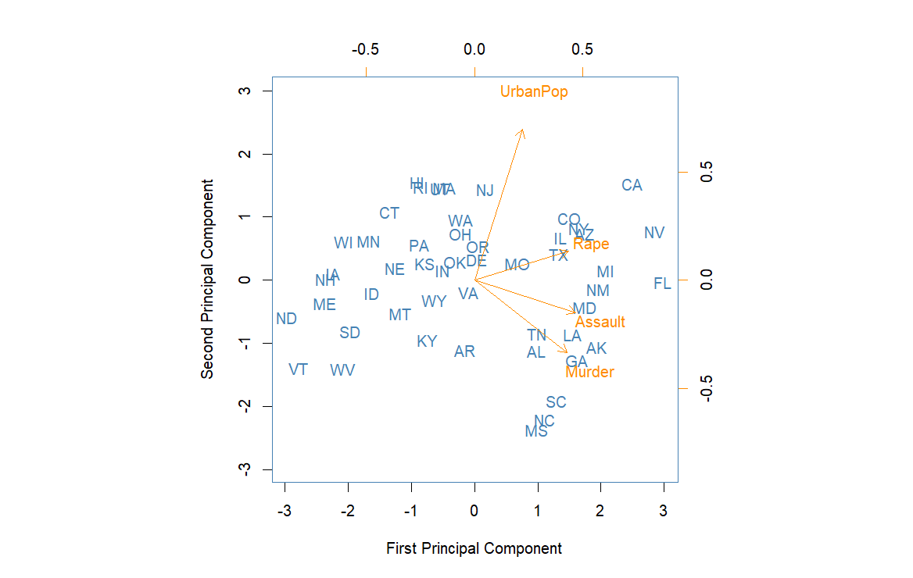
PCA biplot displays PC scores and loadings
Notes:
This figure is known as a biplot, because it displays both the principal component scores and the principal component
loadings.
Bi means two and it is like we squished two plots together
It is common to plot the first two principal components; we could plot others, but the first two usually represent most of the variation.
In the next few slides we will look at this plot in more detail.

Slide 15
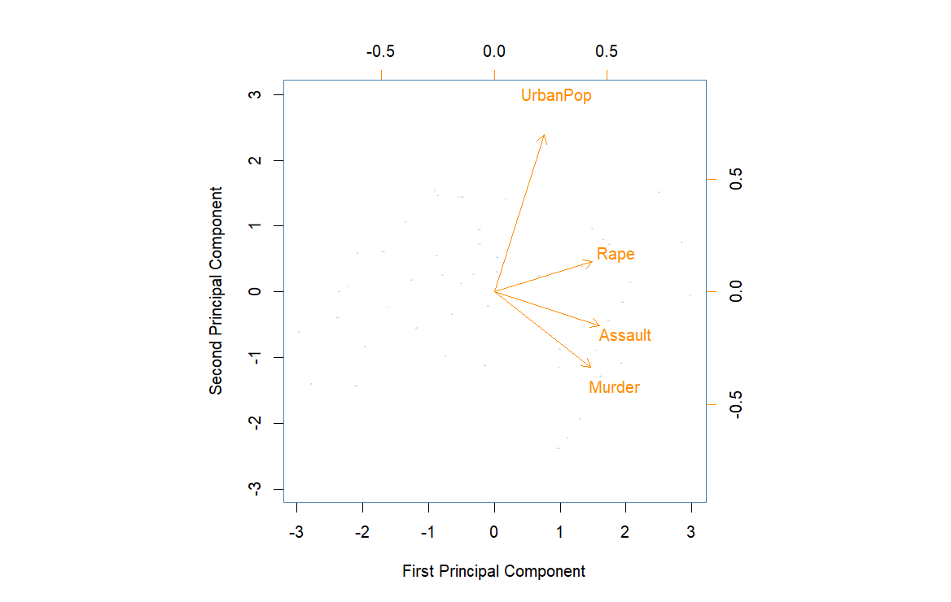
PCA biplot
Score for PC2
Loadings for PC1
Score for PC1
Loadings for PC2
Notes:
We can split the biplot in two and look at the two parts separately.
The top and right axes correspond to the loadings for PC1 and PC2 respectively while the bottom and left axes correspond to the scores for PC1 and PC2 respectively. The next slides go into detail about what the loadings and scores are.

Slide 16
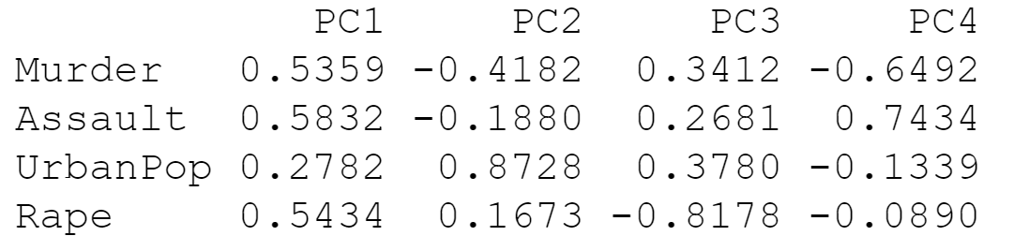
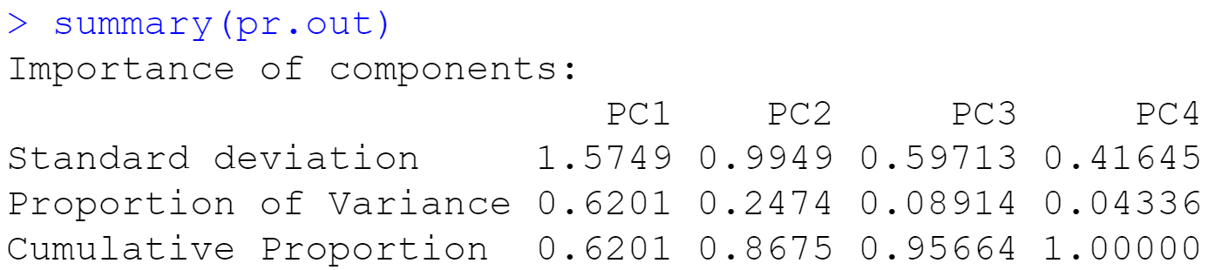
PCA loadings are weights
The loadings are the weights (recall the α’s from the linear equation) of the principal components
4 variables means we can have at most 4 principal components
Loadings for
each PC:
Notes:
The loadings are the weights (recall the alphas from the linear equation) of the principal components
Bottom table: Provides proportion of variance represented by each PC

Slide 17
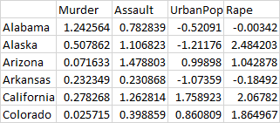
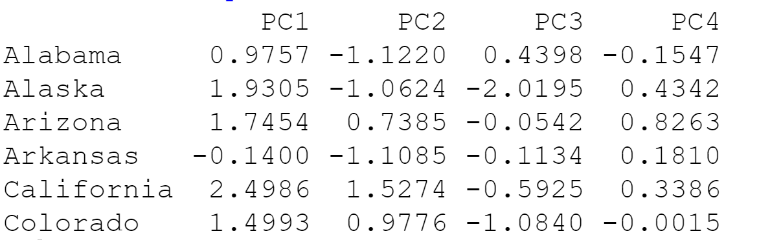
Finding the PCA scores
Matrix-multiply the original data matrix (after standardizing) by the loadings:
We now have the PC scores (coordinates) of the data in the rotated coordinate system:
Principal Component Scores:
Notes:
The scores are found through matrix multiplication. We take the scaled data and multiply it by the loadings which gives this us the scores shown below.
Each observation in the dataset has a score corresponding to each principal component

Slide 18
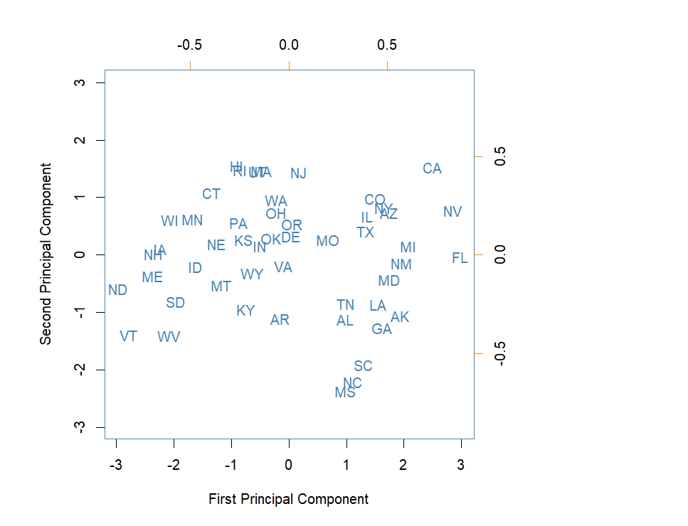

PCA biplot
Notes:
Remember the left plot corresponds to the scores for PC1 and PC2 and we can graph the scores for each observation in the dataset as a point
Remember the right plot corresponds to the loadings for PC1 and PC2 and we graph these loadings usings arrows

Slide 19
PCA biplot
(0.28, 0.87)
(2.50, 1.53)
(-1.97, -0.82)
(0.58, -0.19)
Notes:
Diving into it a little deeper we look at how the points and arrows are graphed.
The points in the left graph are plotted using the scores calculated earlier. For example, if we look at the PCA scores for California, we see that the score for PC1 is –2.5 and the score for PC2 is 1.53. Similarly, the PCA scores for South Dakota are 1.97 for PC1 and –0.82 for PC2
The arrows in the right graph indicate the first two principal component loadings (top is PC1 and right is PC2). The arrows begin at the origin and extend towards the loading point. R is weird and doesn't extend the arrows all the way to the actual point, it places the word in the location where the point actually is. For example, if we look at the loadings for UrbanPop, we see that the loading for PC1 is 0.28 and the loading for PC2 is 0.87. Similarly, the PCA loadings for Assault are 0.58 for PC1 and –0.19 for PC2
We see that the crime-related variables (Murder, Assault, and Rape) are located close to each other, and that the UrbanPop variable is far from the other three. This indicates that the crime-related variables are correlated with each other—states with high murder rates tend to have high assault and rape rates—and that the UrbanPop variable is less correlated
with the other three.

Slide 20
PC1 appears to be a measure of “overall rate of serious crime”
PC1 places roughly equal and higher weight on crime variables and less weight on UrbanPop
Notes:
The loadings can help us identify patterns in our data. We can quickly tell from this plot that all variables have a positive loading on PC1 with assault, murder, and rape having similar loadings that are about twice that of the loading for UrbanPop. That is the loading on PC1 (along the top) is about twice as large for the crime variables than it is for UrbanPop
Using that information we can consider PC1 as some measure of "Overall Rate of Serious Crime".

Slide 21
PC2 appears to be a measure of “level of urbanization”
PC2 places much higher weight on UrbanPop and much less weight on crime variables
Notes:
Similarly, we can look at PC2
We can quickly tell from this plot that UrbanPop and Rape have a positive loading on PC2 whil assault and murder have negative loadings. The three crime variables have loadings similar in magnitude which are about half that of UrbanPop. That is the loading on PC2 (along the side) are about half as large for the crime variables than it is for UrbanPop
Using that information we can consider PC2 as some measure of "Level of Urbanization".

Slide 22
Using PC1 and PC2, we can break the graph into four regions
Overall Rate of Serious Crime
High Urbanization Low Violent Crime
High Urbanization High Violent Crime
Level of Urbanization
Low Urbanization Low Violent Crime
Low Urbanization High Violent Crime
Notes:
The loadings can give us information about the PC scores.
The loading vectors suggests that states with large positive scores on the first component, such as California, Nevada and Florida, have high crime rates, while states like North Dakota and Vermont with negative scores on the first component, have low crime rates. California also has a high score on the second component, indicating a high level of urbanization, while the opposite is true for states like Mississippi. States close to zero on both components, such as Virginia and Indiana, have approximately average levels of both crime and urbanization.
This lets us break the graph into four regions (these aren't hard boundaries! Remember we are just exploring the data)

Slide 23
Summary of PCA biplot
Notes:
In summary,
This plot is called a biplot since it is a combination of two plots
The top and bottom axes are for PC1 while the left and right axes are for PC2
The top and right axes are for the loadings while the left and bottom axes are for the scores
The orange arrows correspond to the loadings (for PC1 and PC2) and there is one for each variable
The blue state abbreviations correspond to the PC scores (there is a score for each principal component for each observation) In this case we are only looking at the scores for PC1 and PC2
The loadings can be used to give some meaning to the principal components (in this case PC1 corresponds to the overall rate of serious crime and PC2 corresponds to the level of urbanization)
Those loadings can give us insight about the observations

Slide 24

How many principal components?
In any data analysis, you can estimate up to p principal components where p is the number of variables. Of course, if you use all p, that doesn’t reduce dimensions.
Goal: Find some number of principal components c < p that represent a large portion of the variability in your original variables.
Look Mom! I had 500 variables but I can explain 89% of the variation in the variables with 4 principal components! Isn’t that exciting!?!
89
This Photo by Unknown Author is licensed under CC BY
Notes:
In general, we can have up to the smaller of p or n-1 principal components, where p is the number of variables and n is the number of observations. But of course, choosing p principal components would not reduce the dimensions in our data at all! Instead, the goal is to find a small number of principal components that explain a large portion of the variability present in the original variables.
we need to find c<p that represents a large portion of the variability.
In the example, we used two principal components.

Slide 25
We want to choose the smallest number of PCs required to explain a “large” percent of the variability in the data
For example, 3 principal components explaining 92% of variation is preferable to 7 principal components explaining 97% of the variation
TRADEOFF
Less PCs More PCs
More data reduction
( + ) easier to visualize
( – ) less flexibility when working with data
Less data reduction
( – ) more difficult to visualize
( + ) more flexibility when working with data
Notes:
But how do we choose the number of principal components? Ideally, We want the smallest number of principal components required to explain a “large” percent of variability ​
Large here is a little subjective. In the example, we used two principal components.
In general, a dataset can produce up to min(𝑛−1, 𝑝) principal components. Number of principal components is limited by the smaller of the number of features (p) and number of observations (n)
For example, 3 components explaining 92% of variation would be preferable to 7 principal components explaining 97%. Even though 7 components explains a higher percent of variation, this does not achieve as much dimension reduction. ​
In general, there is a tradeoff in selecting the number of principal components. The less PCs we have, the more data reduction we achieve and the easier it is to visualize the data, but we will have less flexibility. When we have more PCs, we achieve less data reduction and thus the data is more difficult to visualize, but we will have more flexibility in working with the data. ​
Note that different principal component analyses may be vastly different. A certain analysis on a dataset may give 3 PCs that explain 94% of the variation while an analysis on a different data set with similar variables may give 8 PCs that explain 58% of the variation. You analysis can be heavily dependent on the quality of your data (and we know most data is not the greatest)
Software will give you a Percent of Variability Explained

Slide 26
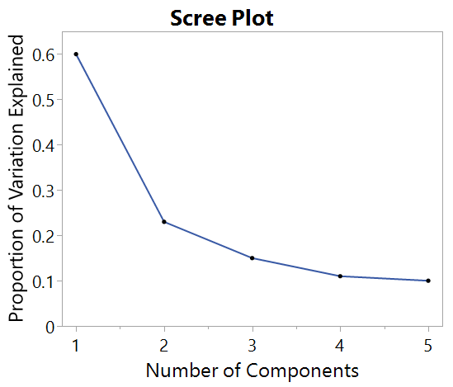
In addition to percent variation explained, scree plots help select the number of principal components
We “eyeball” scree plots to find the “elbow” (i.e., the point at which the proportion of variance explained by each subsequent PC drops off)
In this example, we may opt to use only PC1 and PC2
Notes:
One tool commonly used to aid in selecting the number of principal components is the scree plot. The scree plot for PCA displays the proportion of variability in the data explained as we increase the number of principal components. There is no strict criteria for selecting the number of components this way and it is important to consult a subject matter expert at this stage.
Typically, we look for an elbow shape in the scree plot where the proportion of variance explained by each subsequent principal component drops off. In other words, we would have little to gain in terms of variability explained by adding more components beyond the number of components found at the elbow.
In this graph, there seems to be an elbow after the second component
The third principal component explains less than ten percent of the variance in the data
We might opt to have only two principal components

Slide 27
Scree plot warnings
The “elbow” is not always clear
Scree plots tend to overestimate the number of PCs
Why not just use cross-validation? In unsupervised learning, we are not predicting a response. So there really is no measure of error that we can use CV to minimize
Good
Not so good
The “Elbow”
No “Elbow”
Notes:
Note that it is sometimes unclear where the elbow lies on the plot or there may be multiple elbows, but these plots can still give you a rough idea of how many components you may want.
Another warning with these plots is that they tends to overestimate the number of components needed. Remember, these plots can be used to help make a judgement call. Often whether or not you use a component doesn’t only depend on the variability it explains but also the interpretability of that component. If a component doesn’t make sense to your subject matter expert and only explains 4% of the variability, it is less likely that you should use that component.
You may be thinking, why not just use cross validation to select the number of components, similar to what we’ve seen in other machine learning techniques? Since we are in the unsupervised learning context and we are not doing prediction, there is really no measure of error that we can minimize in cross validation.
Note: Eigenvalues can also be used to select the number of PCs with >1 criteria but that is beyond the scope of this course

Slide 28
Unsupervised Learning

Slide 29

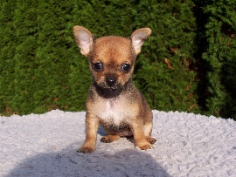
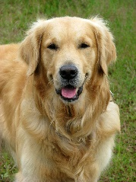





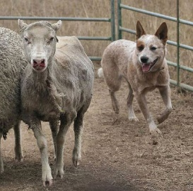

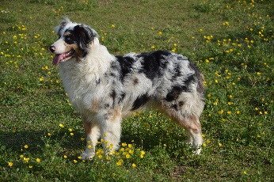
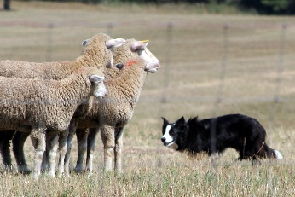



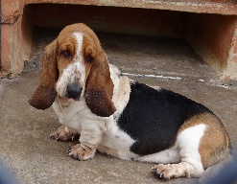


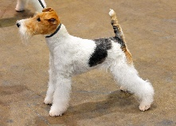
Clustering dogs based on genetics
Retrievers
Toy Dogs
Herding Dogs
Terriers
Scent Hounds
And several more clusters…
This Photo by Unknown Author is licensed under CC BY-SA
This Photo by Unknown Author is licensed under CC BY-SA
This Photo by Unknown Author is licensed under CC BY-SA
Notes:
Motivating example: Clustering the canine family based on DNA analysis into groups like wolves, toy dogs, spaniels, herding dogs, retrievers, terriers, scent hounds, sight hound, etc.
https://www.instituteofcaninebiology.org/how-to-read-a-dendrogram.html

Slide 30
Clustering
Clustering involves partitioning the observations into distinct groups so that the observations within each group are quite “similar” to each other, while observations in different groups are quite “different” from each other
What constitutes “different” or “similar” is based on domain knowledge and is determined by the analyst
We will examine two clustering methods:
K-means clustering
Hierarchical clustering
Notes:
Motivating example: Clustering the canine family based on DNA analysis into groups like wolves, toy dogs, spaniels, herding dogs, retrievers, terriers, scent hounds, sight hound, etc.
https://www.instituteofcaninebiology.org/how-to-read-a-dendrogram.html
Common clustering algorithms are not suitable for clustering categorical data largely because the distance functions used for continuous data are not applicable for categorical data.
There is no clear option for incorporating categorical variables, but researchers have proposed some alternatives:
https://www.r-bloggers.com/2016/06/clustering-mixed-data-types-in-r/
k-modes as an option for categorical data

Slide 31
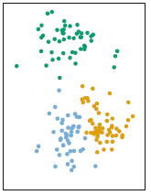
K-means Clustering
In K-means clustering we seek to partition the observations into a pre-specified distinct and non-overlapping number of clusters
The algorithm works by assigning observations that are “close” to each other, to the same group
The analyst can change the scales of the variables to add more weight to variables that imply greater similarity and vice versa

Slide 32
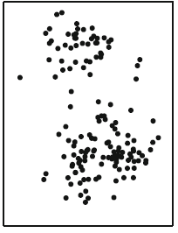
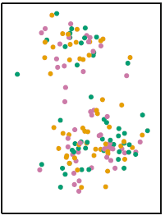
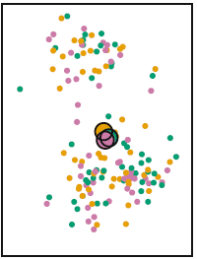
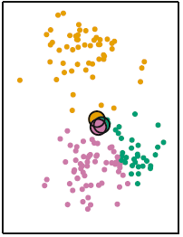
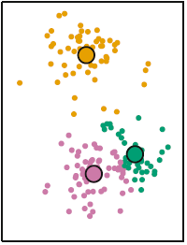
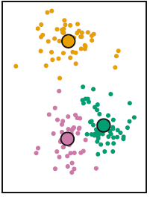
How k-means clustering works
The final output will change depending on:
your choice of K
the random numbers that get assigned in step 1 by the algorithm.
We can mitigate the effect of (b) by running the algorithm multiple times and choosing the run with the points closest to their respective centroids
Step 1
Step 2
Step 3
Repeat 2 - 3
Final
Notes:
First, the algorithm assigns a random number to each observation from 1 to k where k is the pre-specified number of groups.
The algorithm then computes the centroid, which can be thought of as the average value across all features within a specific group.
The algorithm then reassigns the group numbers it assigned in step (1), such that each point is reassigned to the group whose centroid is closest.
Finally, the algorithm repeats the above steps until no changes occur in the group assignments.

Slide 33
PCA & Clustering

Slide 34
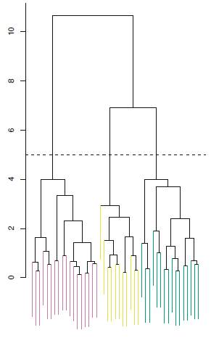
Hierarchical clustering
Hierarchical clustering is a technique that creates levels of separation
Unlike K-means clustering, hierarchical clustering does not require the analyst to pre-specify a number of groups
However, there is still a way we can limit the number of clusters produced by the algorithm
Notes:
Hierarchical clustering is a technique that creates levels of separation. This is not unlike what we encountered in tree-based methods.
Unlike K-means clustering, hierarchical clustering does not require the analyst to pre-specify a number of groups.
However, there is still a way we can limit the number of clusters produced by the algorithm.
Dendrogram y-axis is dissimilarity distance

Slide 35
Hierarchical clustering
observations are less similar
The hierarchical clustering algorithm, like the K-means algorithm, is also based on how close observations are to each other in the feature space (i.e. general proximity across all features)
observations are more similar
Notes:
The hierarchical clustering algorithm, like the K-means algorithm, is also based on how close observations are to each other in the feature space (i.e. general proximity across all features).
This leads to the nested structure we observe where observations that arise from similar branches are more similar. The more you have to go up the tree to find a common branch, the less similar the observations
Height represents the distance between observations and clusters
Dendrogram y-axis is dissimilarity distance

Slide 36
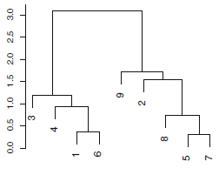
Interpret dendrograms vertically not horizontally
Consider observations 9, 2, 5, 7, 8
9 is just as dissimilar from 2 as it is from 5, 7, & 8. The common branch (green) between 2 and 9, is also the common branch between each of 5, 7, 8 and 9
Observations like 5 & 7 which are already sharing a branch, are the most similar
Notes:
Consider observations 9, 2, 5, 7, 8
9 is just as dissimilar from 2 as it is from 5, 7, & 8. The common branch (green) between 2 and 9, is also the common branch between each of 5, 7, 8 and 9
Observations like 5 & 7 which are already sharing a branch, are the most similar
Dendrogram y-axis is dissimilarity distance

Slide 37
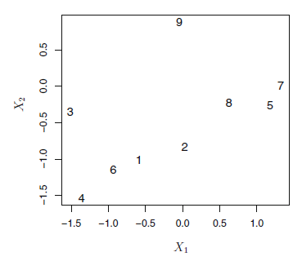
Let’s compare the dendrogram to our original space
Notes:
Consider the observations again but looking at the feature space. X1 and X2 are our features. They aren’t identified in the big (maybe consider them to be the difference in the height of a child and the national average for their age and the difference in height of their mother and the national average for their age)
Consider observations 9, 2, 5, 7, 8
9 is just as dissimilar from 2 as it is from 5, 7, & 8. The common branch (green) between 2 and 9, is also the common branch between each of 5, 7, 8 and 9
Observations like 5 & 7 which are already sharing a branch, are the most similar
Dendrogram y-axis is dissimilarity distance

Slide 38
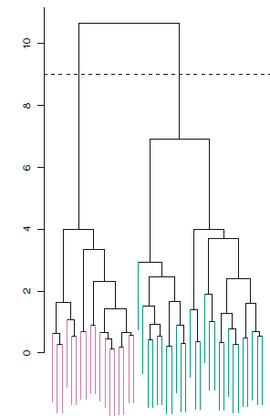
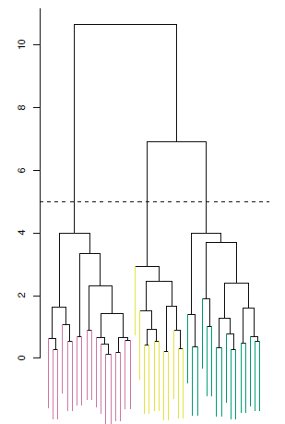
Hierarchical clustering
Given this hierarchical structure, we can control the number of groups by controlling the level at which we “cut” the tree:
higher cut
lower cut
Notes:
Given this hierarchical structure, we can control the number of groups by controlling the level at which we “cut” the tree.
Notice how the higher cut (one level of difference) leads to 2 groups/clusters while a lower level cut leads to more groups (taking more differences into account).
One single dendrogram can lead to a variety of different numbers of clusters
Dendrogram y-axis is dissimilarity distance

Slide 39
Drawback of hierarchical clustering
Two natural clusters by Generation
Three natural clusters by Nationality
Cut at k = 2
Cut at k = 3
???
Millennials
American
Gen Z
Japanese
French
Notes:
Notes:
One drawback of this approach is that it forces data into a hierarchical form, which may not be appropriate, for example:
Suppose our observations correspond to a group of people and we consider their generation (represented by shape) and nationality (represented by color)
We’ll say there is 50–50 split between millennial and gen z, and there is an even split among American, Japanese, and French.
We can have a scenario in which the best division into two groups splits these people by gender, while the best division into three groups splits them by nationality.
In this case, the desired “best” division into three groups does not result from hierarchical clustering. Forcing the data into a hierarchical structure may produce limitations that are incompatible with the data.
In cases such as these, K-means will offer superior results

Slide 40
Dissimilarity between clusters
Distance Metric:
(e.g. Euclidean Distance, etc)
How do we determine whether two observations are close in a feature space?
Easy!
Linkage: measure of dissimilarity used to decide whether to fuse two clusters or not
How do we determine whether two groups of observations are close in a feature space?
???
Notes:
Notes:
Before describing the algorithm, we need to address one issue; we can easily determine whether or not two observations are close in a feature space using distance metric (typically Euclidean distance), but how do we determine whether two groups of observations are close in a feature space?
We use linkages. Linkages are measures of dissimilarity that is used to decide whether or not to fuse two clusters containing more than 1 observation in at least one of them

Slide 41
We will examine four common types of linkages
Max?
Avg?
Min?
Maximum Pairwise Distance
Minimum Pairwise Distance
Average Pairwise Distance
Distance between Centroids
Linkage Type:
Complete Linkage
Single Linkage
Average Linkage
Centroid Linkage
Notes:
Notes:
We will examine four common types of linkages. The first three linkages are calculated similarly. Say you want to determine the dissimilarity between two clusters. First, you calculate all pairwise differences between the points in one cluster and the points in the other cluster. Complete linkage is where you can the maximum of those pairwise distances as the measure of dissimilarity. Similarly, if you take the minimum of these distances, it’s called single linkage. If you take the average of these pairwise distances, it’s called average linkage.
To determine the fourth linkage, instead of calculating the pairwise distances between points you calculate the distance between the centroids of the two clusters. This is called centroid linkage.
Average, complete, and single preferred most among statisticians. Average and complete linkage are generally preferred over single linkage, as they tend to yield more balanced dendrograms. Different linkages will give you different numbers of clusters and/or different cluster compositions. Consider the scientific question.
Complete - Maximal intercluster dissimilarity. Compute all pairwise dissimilarities between the observations in cluster A and the observations in cluster B, and record the largest of these dissimilarities.
Single - Minimal intercluster dissimilarity. Compute all pairwise dissimilarities between the observations in cluster A and the observations in cluster B, and record the smallest of these dissimilarities. Single linkage can result in extended, trailing clusters in which single observations are fused one-at-a-time.
Average - Mean intercluster dissimilarity. Compute all pairwise dissimilarities between the observations in cluster A and the observations in cluster B, and record the average of these dissimilarities.
Centroid - Dissimilarity between the centroid for cluster A (a mean vector of length p) and the centroid for cluster B. Centroid linkage can result in undesirable inversions.
See textbook for discussion of which to use.

Slide 42
Hierarchical clustering procedure
Compute a measure of distance between each pair of observations
Compute all pairwise
inter-cluster dissimilarities (using a linkage of your choice)
Fuse the two “closest” observations
Fuse the two clusters that are least dissimilar
Repeat until all observations are fused together
Notes:
Notes:
Here’s how hierarchical clustering works:
First, compute a measure of distance (most often Euclidean distance) between each pair of observations
Then fuse the two points with the shortest distance between them to form the first cluster
Then compute a pairwise measure of dissimilarity, using the linkage of your choice, between all of the clusters.
Then fuse the two cluster that result in the lowest measure of dissimilarity.
Then we repeat the process, again compute all pairwise measures of disimialirty between the current clusters. At this stage, many of your “clusters” will be individual points but as you repeat the process, you will continue grouping observations until all points have been fused together.

Slide 43
Hierarchical clustering connection to dendrogram
Notes:
Notes:
Here is the relation to a dendrogram. We will go through the clustering done on the previous slide but draw the dendrogram as we go.
First, we compute a measure of distance between each pair of observations then fuse the two points with the shortest distance between them to form the first cluster
** animation**
We see that the two points fused together to create the first cluster are the cyan circle and yellow circle
** animation**
And we can connect those points in our dendrogram.
Then compute a pairwise measure of dissimilarity, using the linkage of your choice, between all of the clusters.
Then fuse the two cluster that result in the lowest measure of dissimilarity.
** animation**
We see that the the first cluster we created fused with the red circle
** animation**
We then add that connect to our dendrogram
Then we repeat the process again until all points are fused together, and we draw the dendrogram as we go
** animation**

Slide 44
Practical issues in clustering
Should I standardize the data?
Hierarchical:
What dissimilarity measure should be used?
What type of linkage should be used?
Where should we cut the dendrogram in order to obtain clusters?
K-means
How many clusters?
Validating clusters? – There is not one accepted methodology. See this book for a discussion: https://web.stanford.edu/~hastie/ElemStatLearn/
Warning: Outliers can distort clusters. Again, see this book for a discussion: https://web.stanford.edu/~hastie/ElemStatLearn/
Notes:
Typically, the data is standardized to make fair comparisons
There may be established conventions in your field, but think critically about if those conventions are correct
Idea of validating clusters is that you could run a new data set through the clustering algorithm and the same patterns would emerge; a lot people have tried to create inferential methods
Elements of Statistical Learning

Slide 45
Practical advice on clustering
Unsupervised learning is about discovering patterns & relationships
Try multiple techniques
Report results judiciously
Clustering ≠ “Absolute Truth”, rather a starting point for discovery
Notes:
Remember, it’s unsupervised learning. It is looking for patterns and relationships.

Slide 46

Exercise 1: PCA for visualization
For our first exercise, we will perform PCA on the Countries data set and look at some visualizations.
Data set: 167 observations and 10 variables which include the country name and 9 variables on various health and economic variables including child_mort, exports, imports, health, income, inflation, life_expec, total_fer, and gdpp.

Slide 47
1) We begin by creating a scree plot and cumulative variance plot.
Python Code
pca = PCA()
pca_Countries = pca.fit(Countries_scaled.iloc[:, 1:])
sns.lineplot(x = range(1, 10), y = pca_Countries.explained_variance_ratio_, color = 'black’)
sns.lineplot(x = range(1, 10), y = np.cumsum(pca_Countries.explained_variance_ratio_),
drawstyle = 'steps-post', color = "black")
plt.axhline(0.90, color = 'orange')
Fitting the PCA and creating the two plots

Slide 48
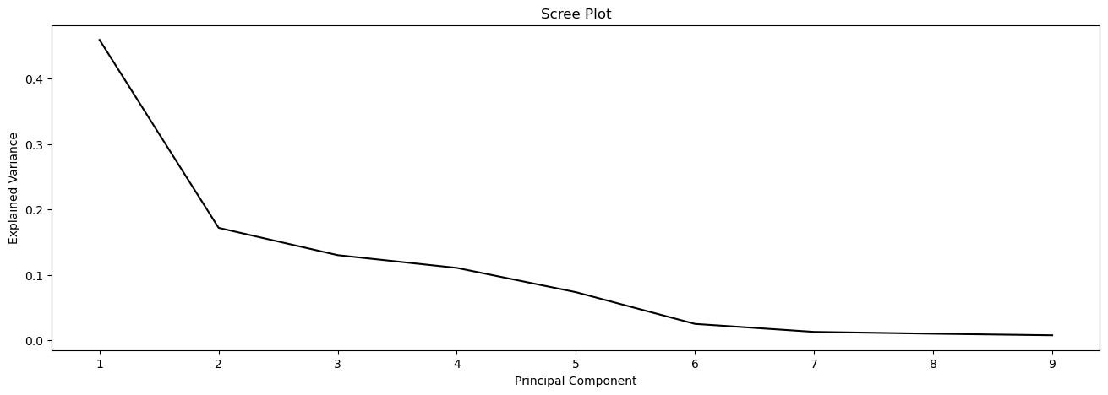
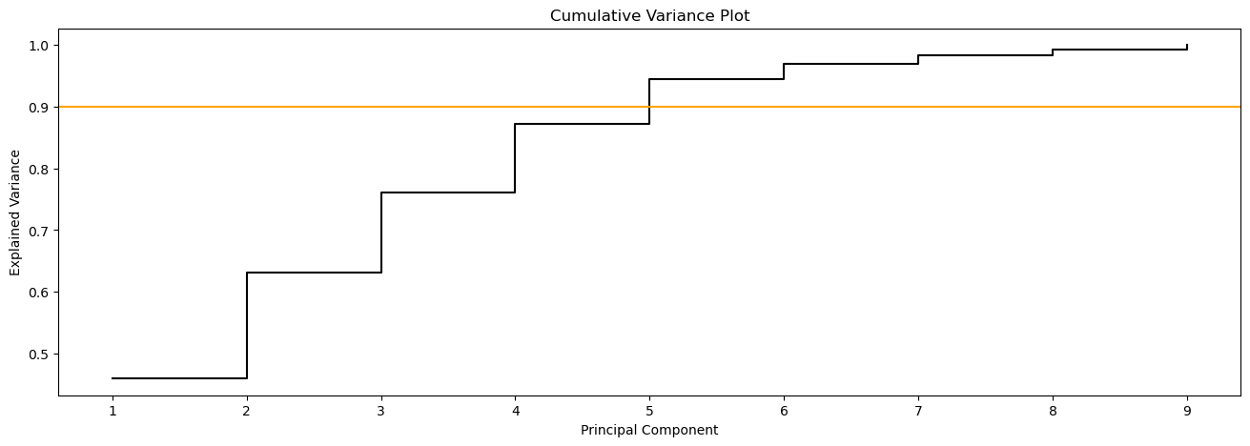
Scree plot and cumulative variance plot

Slide 49
2) Here we create a biplot for the first two principal components
Python Code
Arrow size
i, j = 0, 1
scale_arrow = s_ = 6
scores[:,1] *= -1
pca_Countries.components_[1] *= -1 # flip the y-axis
fig, ax = plt.subplots(1, 1, figsize = (8, 8))
ax.scatter(scores[:, 0], scores[:, 1])
ax.set_xlabel('PC%d' % (i + 1))
ax.set_ylabel('PC%d' % (j + 1))
for k in range(pca_Countries.components_.shape[1]):
ax.arrow(0, 0, s_*pca_Countries.components_[i, k], s_*pca_Countries.components_[j, k])
ax.text(s_*pca_Countries.components_[i, k],
s_*pca_Countries.components_[j, k],
Countries.columns[k + 1])
Reverse the first PC
Creating the biplot
Adding the arrows and labels

Slide 50
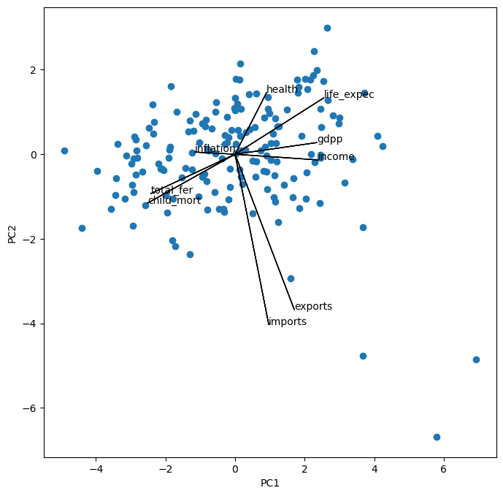
Biplot for the first two principal components

Slide 51
Exercise 2: Classifying countries with clustering
For our second exercise, we will cluster the countries using hierarchical clustering.
1) We begin by creating the full tree/dendrogram (each country in its own cluster).
2) We then implement a cut to achieve only three clusters.
Python Code
Implementing HC and plotting the results
HClustFull_Complete = AgglomerativeClustering(linkage = 'complete', n_clusters = None, distance_threshold = 0).fit(Countries.iloc[:, 1:])
plot_dendrogram(HClustFull_Complete, truncate_mode = 'level', p = 10, color_threshold = 0)
HClustThree_Complete = AgglomerativeClustering(linkage = 'complete', n_clusters = 3,
compute_distances = True).fit(Countries.iloc[:,1:])
plot_dendrogram(HClustThree_Complete, truncate_mode = 'level', p = 50, color_threshold = 80000)
n_clusters = 3 for 3 clusters

Slide 52
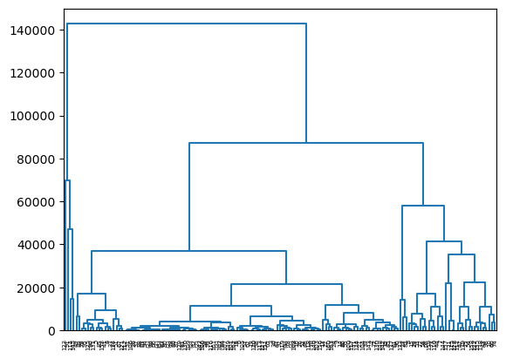
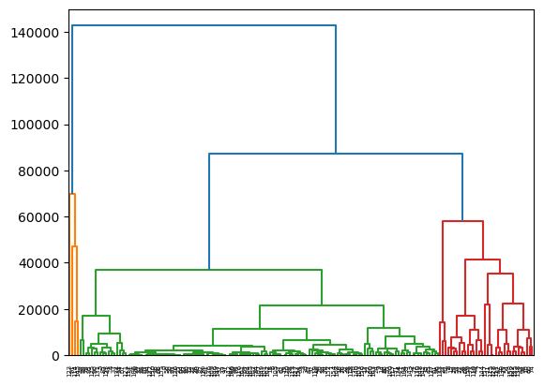
Dendrograms

Slide 53
Exercise 3: K-means with principal components
For our third exercise, we will cluster the countries using k-means clustering using PCs.
1) We begin by fitting the PCA (with 5 components), then run k-means clustering, and finally plot those clusters for the first two principal components.
Python Code
Fit the PCA
pca = PCA(n_components = 5).fit_transform(Countries.iloc[:, 1:])
pca_Countries = pd.DataFrame(pca, columns=['PC'+ str(i) for i in range(1, pca.shape[1] + 1)])
kmeans_unscaled = KMeans(n_clusters = num_clusters, n_init = 20).fit(pca_Countries)
clust_labels = list(kmeans_unscaled.labels_)
plt.scatter(pca_Countries['PC1'], pca_Countries['PC2'], c = clust_labels, cmap = 'viridis')
Implement k-means and get labels
Plot the results

Slide 54
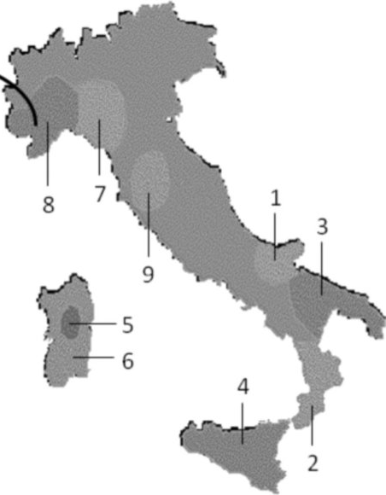
Exercise 4: Clustering with clustered data
For our fourth exercise, we will investigate how well clustering does on data that is actually clustered. Use the Olive Oil data set.
Data set: 572 observations and 9 variables which include the region the oil is from, and 8 measurements of certain fatty acids contained in the oils. The goal is to cluster into the regions based on fatty acid measurement.
Regions:
Northern Apulia
Calabria
Southern Apulia
Sicily
Inner Sardinia
Coastal Sardinia
Eastern Liguria
Western Liguria
Umbria

Slide 55
Exercise 4: Clustering with clustered data
Python Code
Implement k-means and create confusion matrix
kmeans_scaled = KMeans(n_clusters = 9, n_init = 20).fit(OliveOil_scaled.iloc[:, 1:])
clust_labels_scaled = kmeans_scaled.labels_.tolist()
conf_mat = confusion_table(OliveOil['Area.name'], clust_labels_scaled)
cnt = 0
for i in range(9):
cnt += confusion_matrix(OliveOil['Area.name'], predicted_labels_scaled)[i][i]
print("Accuracy rate: " + str(round(cnt/len(OliveOil), 3)))
Compute the accuracy of the clustering

Slide 56
Unsupervised Learning

Slide 57
Introduction to Machine Learning Course Roadmap
What is the goal of the data analysis?
Predict an output |  |  |  |  |  | Reveal patterns or relationships |  | Make decisions using an autonomous agent
Supervised Learning (Output in the data set) |  |  |  |  |  | Unsupervised Learning (No output in the data set) |  | Reinforcement Learning* (Supervised & unsupervised)
Continuous or discrete output? |  |  |  |  |  | What is the subgoal? |  | Does a model exist?
Continuous |  |  | Discrete |  |  | Identify groups | Reduce dimensions | Model Based | Model Free
Simple linear regression Multiple linear regression Subset selection Ridge regression & LASSO PCR & PLS | Polynomial regression Step functions Splines Local regression General additive models | Decision tree Random forest Neural network Gradient boosting tree | Logistic regression Linear discriminant analysis Quadratic discriminant analysis | Decision tree Random forest Neural network Gradient boosting tree | Support vector machines | Hierarchical clustering K-means clustering | Principal components analysis | Given the model Learn the model | Policy Optimization Q-Learning
Hierarchical clustering
K-means clustering
Principal components analysis
*Advanced Topic: Bonus module if time
Notes:
In the previous modules, we discussed supervised learning methods for situations where we have a response of interest that we would like to predict. Now we are going to move to the area of unsupervised learning where we no longer have a response. Our goal now shifts to either identifying groups or reducing dimensions

Slide 58
Now you should be able to:
Identify when unsupervised learning methods might be used
Describe the basic idea behind principal components analysis
Describe the general procedure for k-means clustering
Describe hierarchical clustering and how it differs from k-means clustering
Implement PCA and Clustering methods in Python

